Slide 1
Social Entrepreneurship in West Africa.
How can it work?
Dr. Johanna Richter

Slide 2
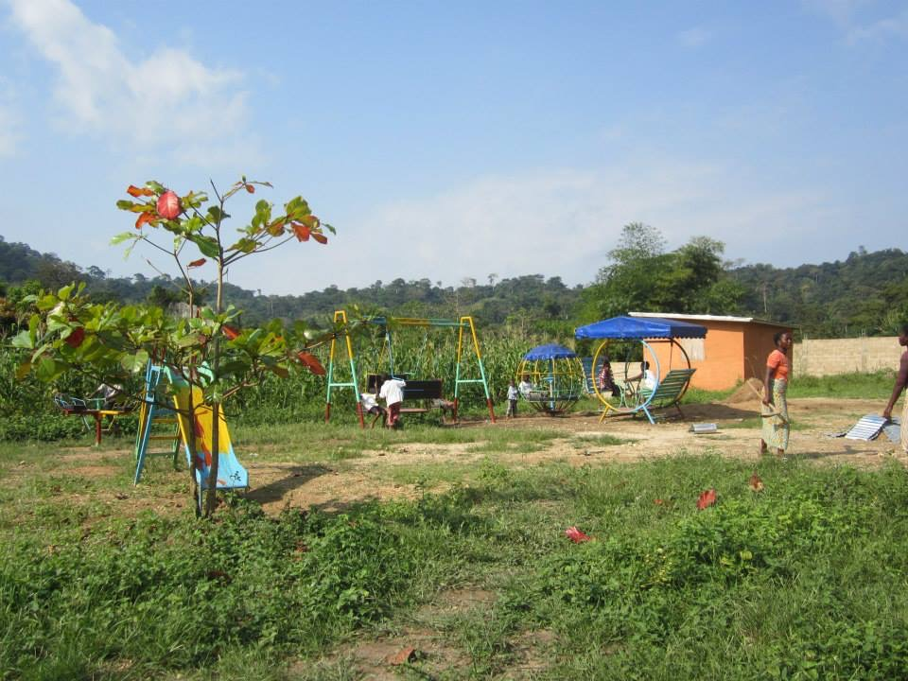

Slide 3
Why a kindergarten?
Why not a new hospital? Running water? Electricity?
Support for families (especially the mothers)
Their wish

Slide 4
Who am I to decide what is best for others?
Privilegs (money, travel, „education“)
Cultural and social differences
Who knows what is best?
Social engagement only for one‘s CV?

Slide 6
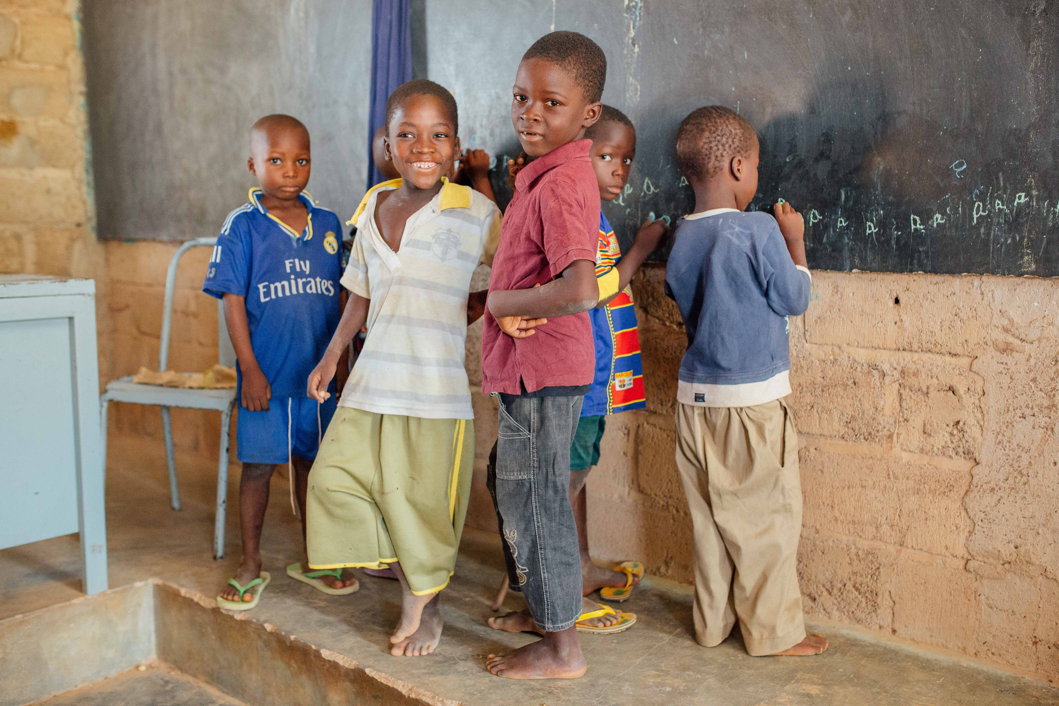

Slide 7
What is Social Entrepreneurship to you?

Slide 8
„give a man a fish and he will eat for one day. Teach him how to fish he will feed himself for a lifetime“
BUT
Social Entrepreneurship means: “revolutionalze the fish industry“

Slide 9
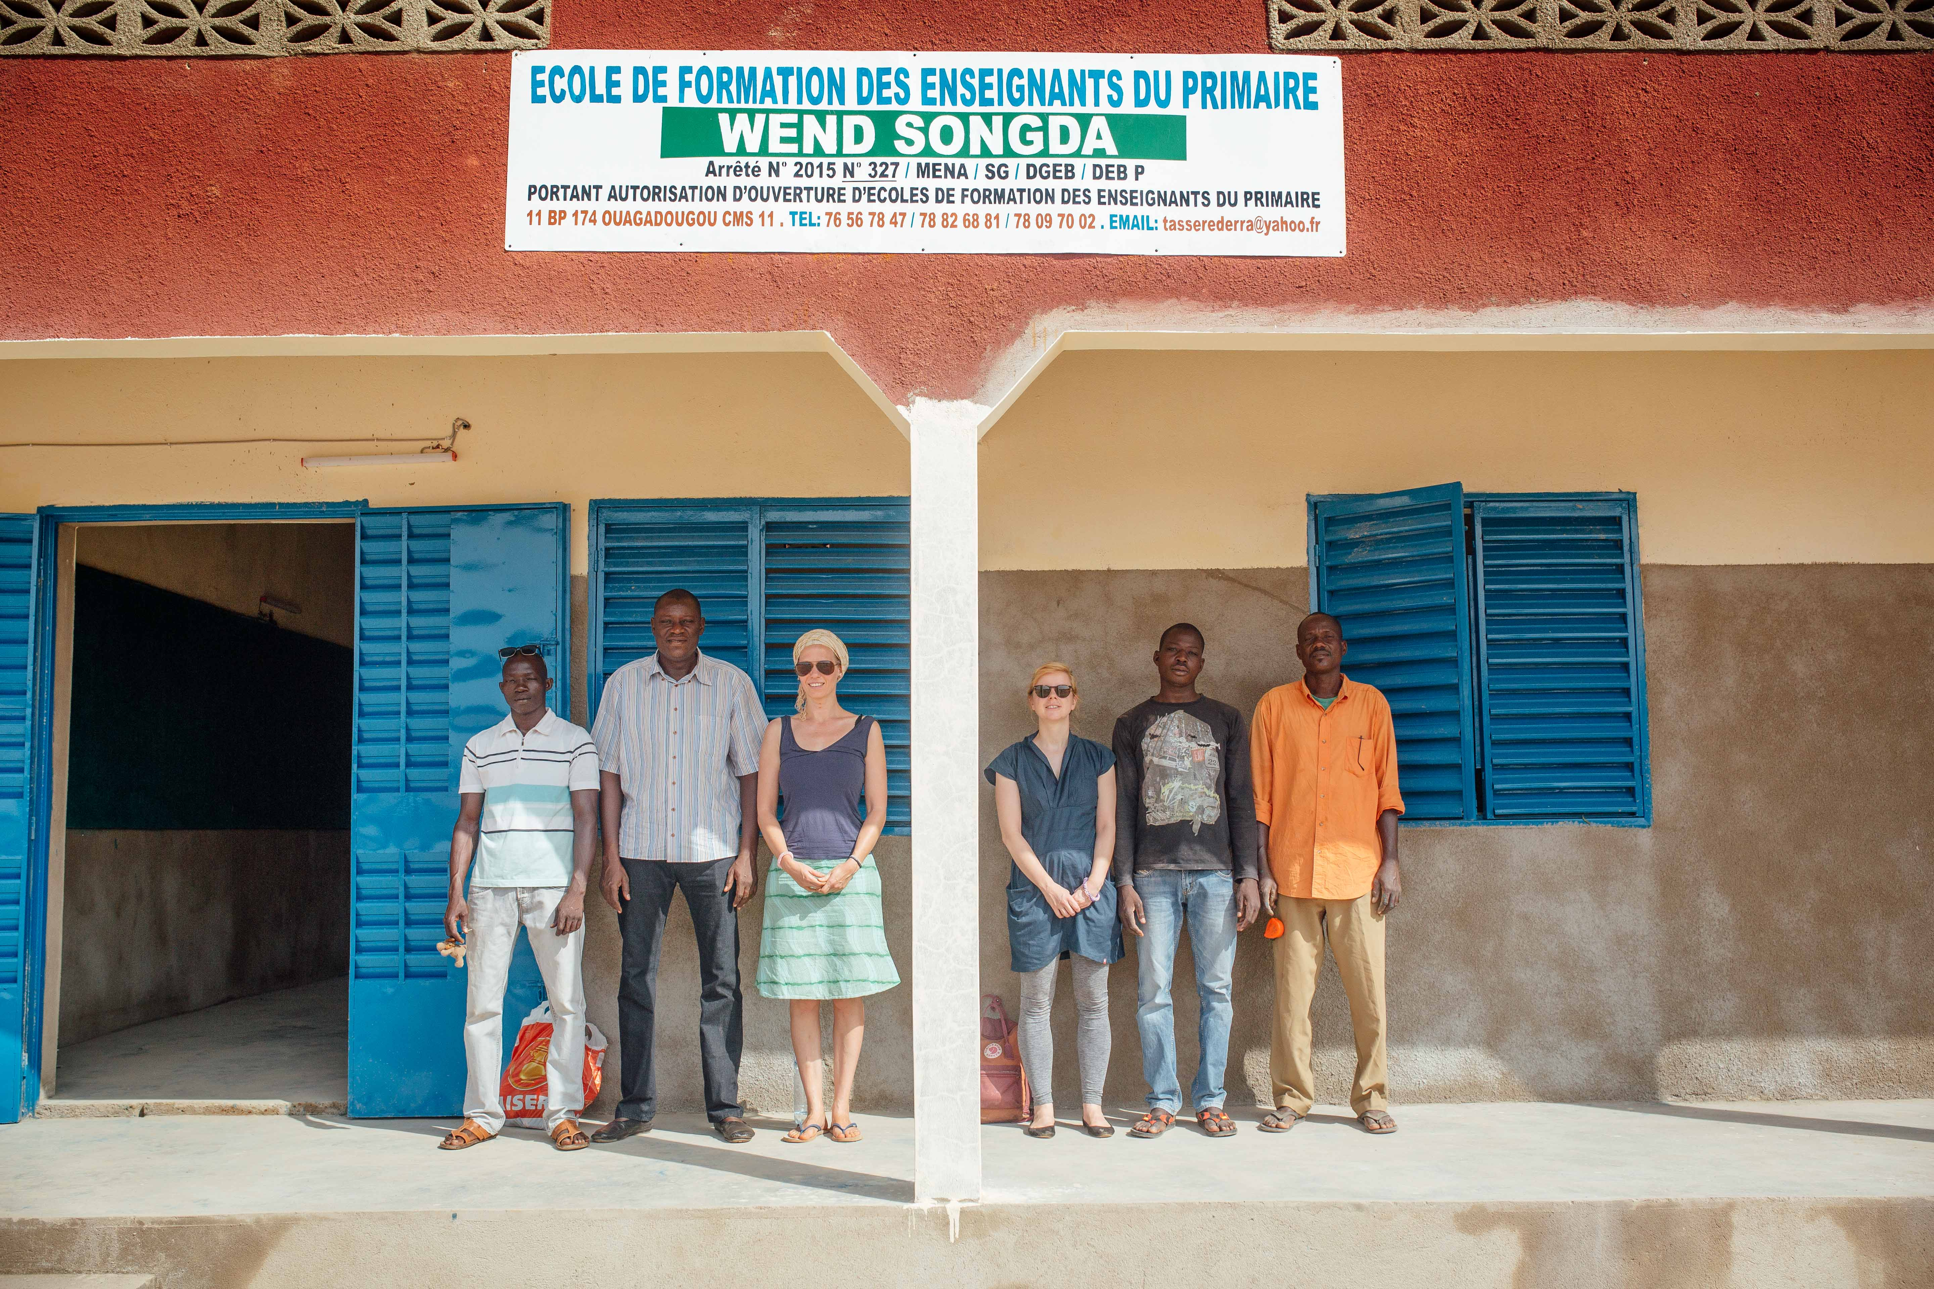

Slide 10
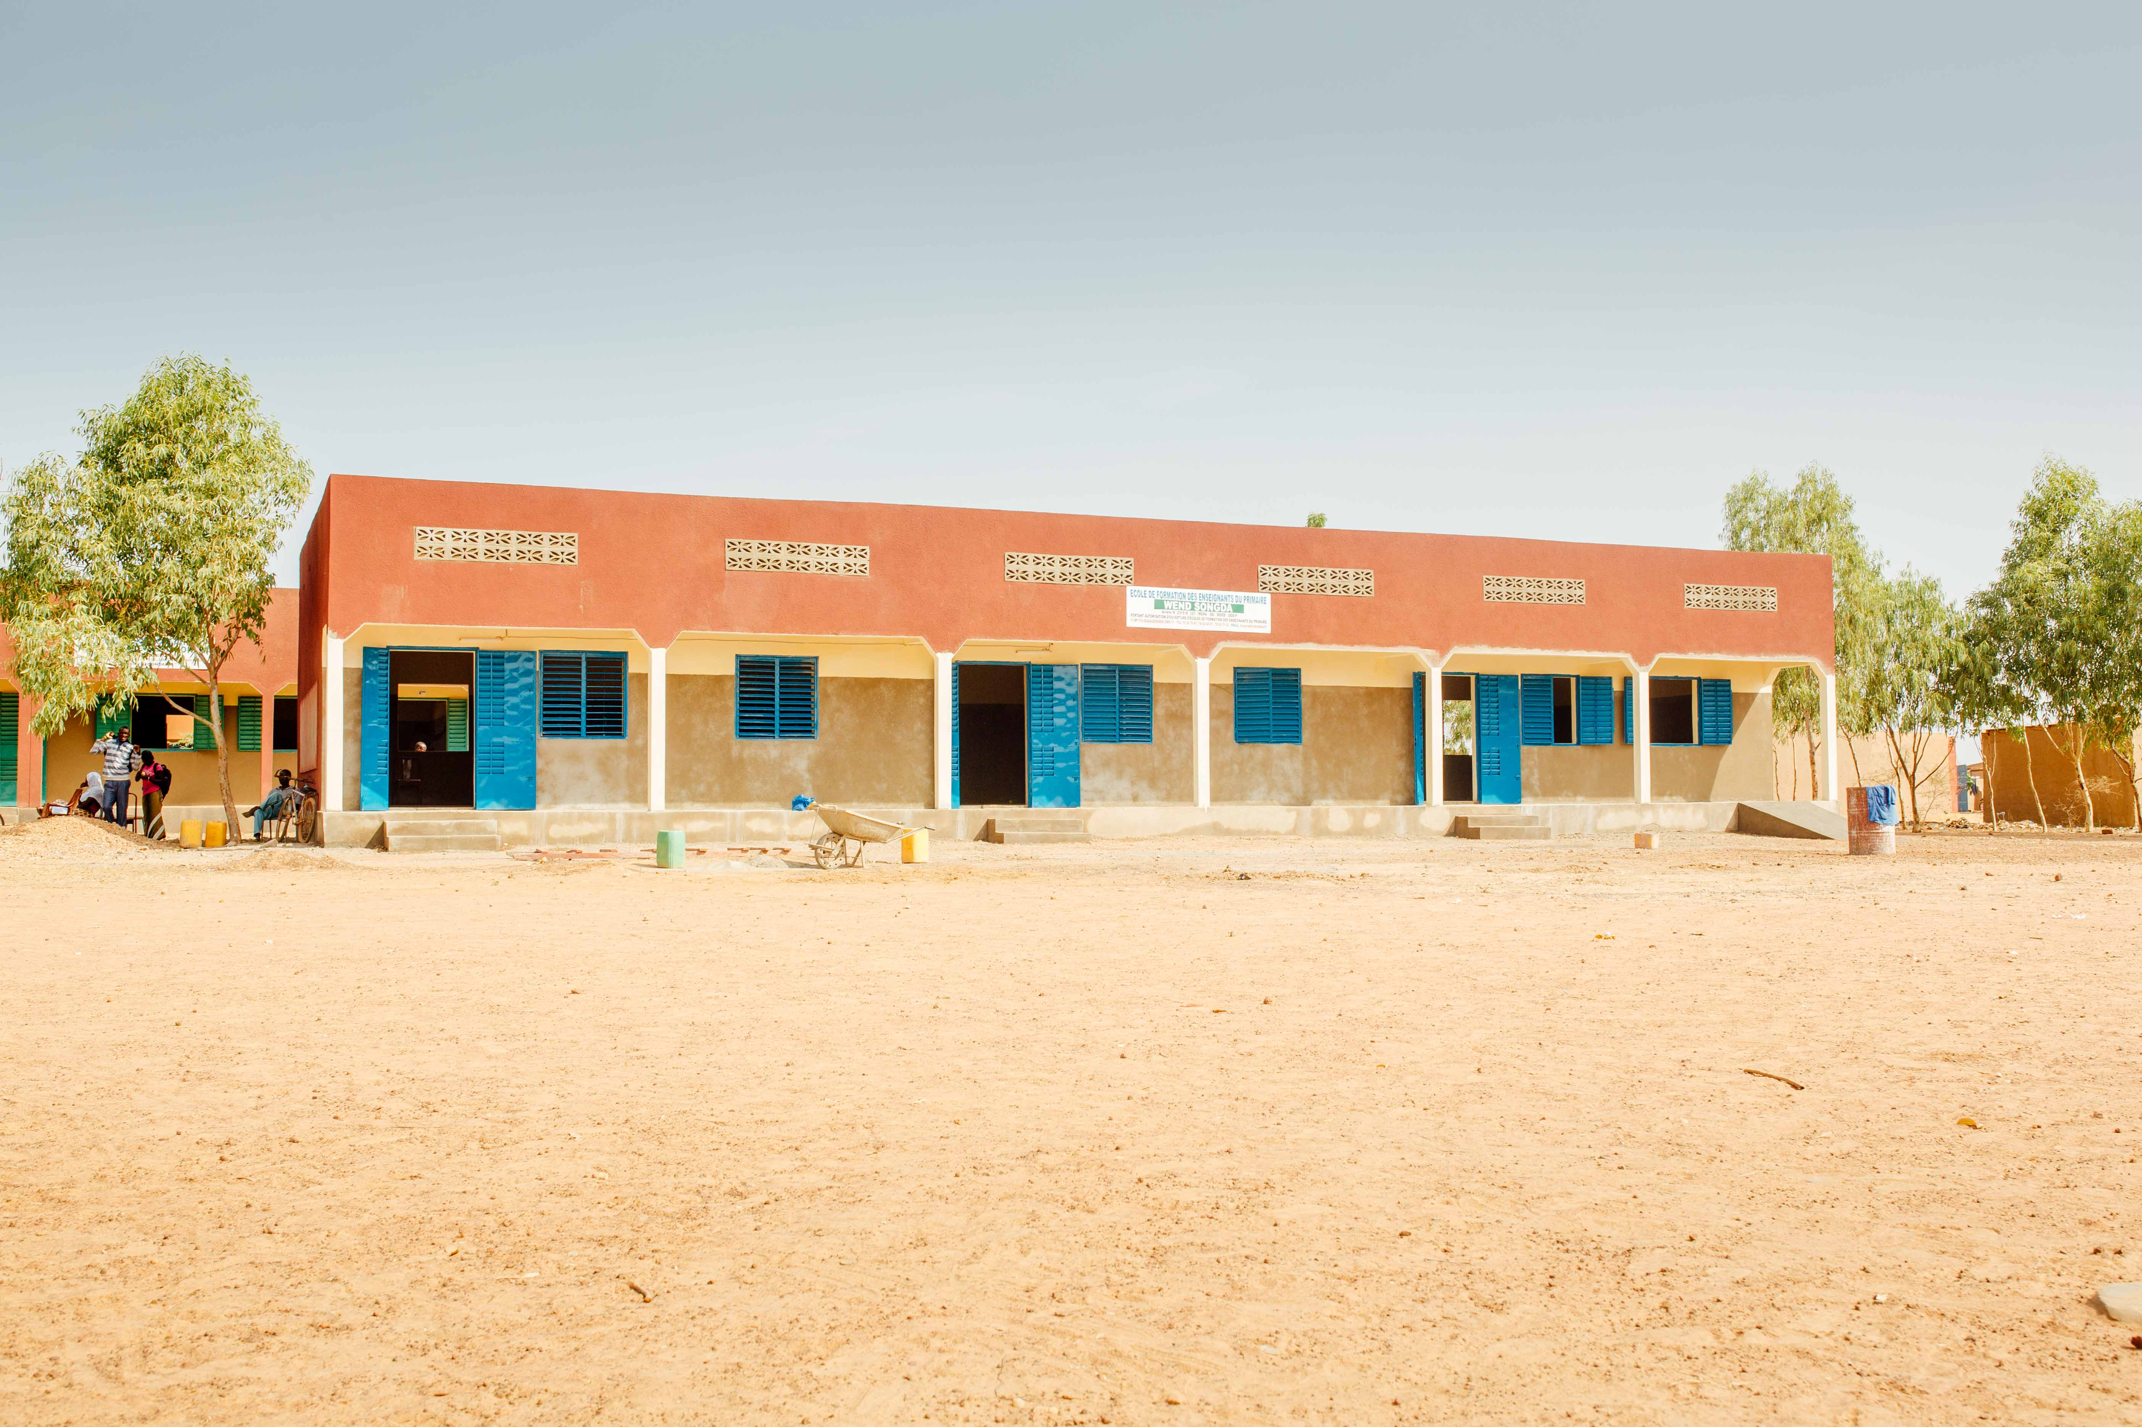

Slide 11
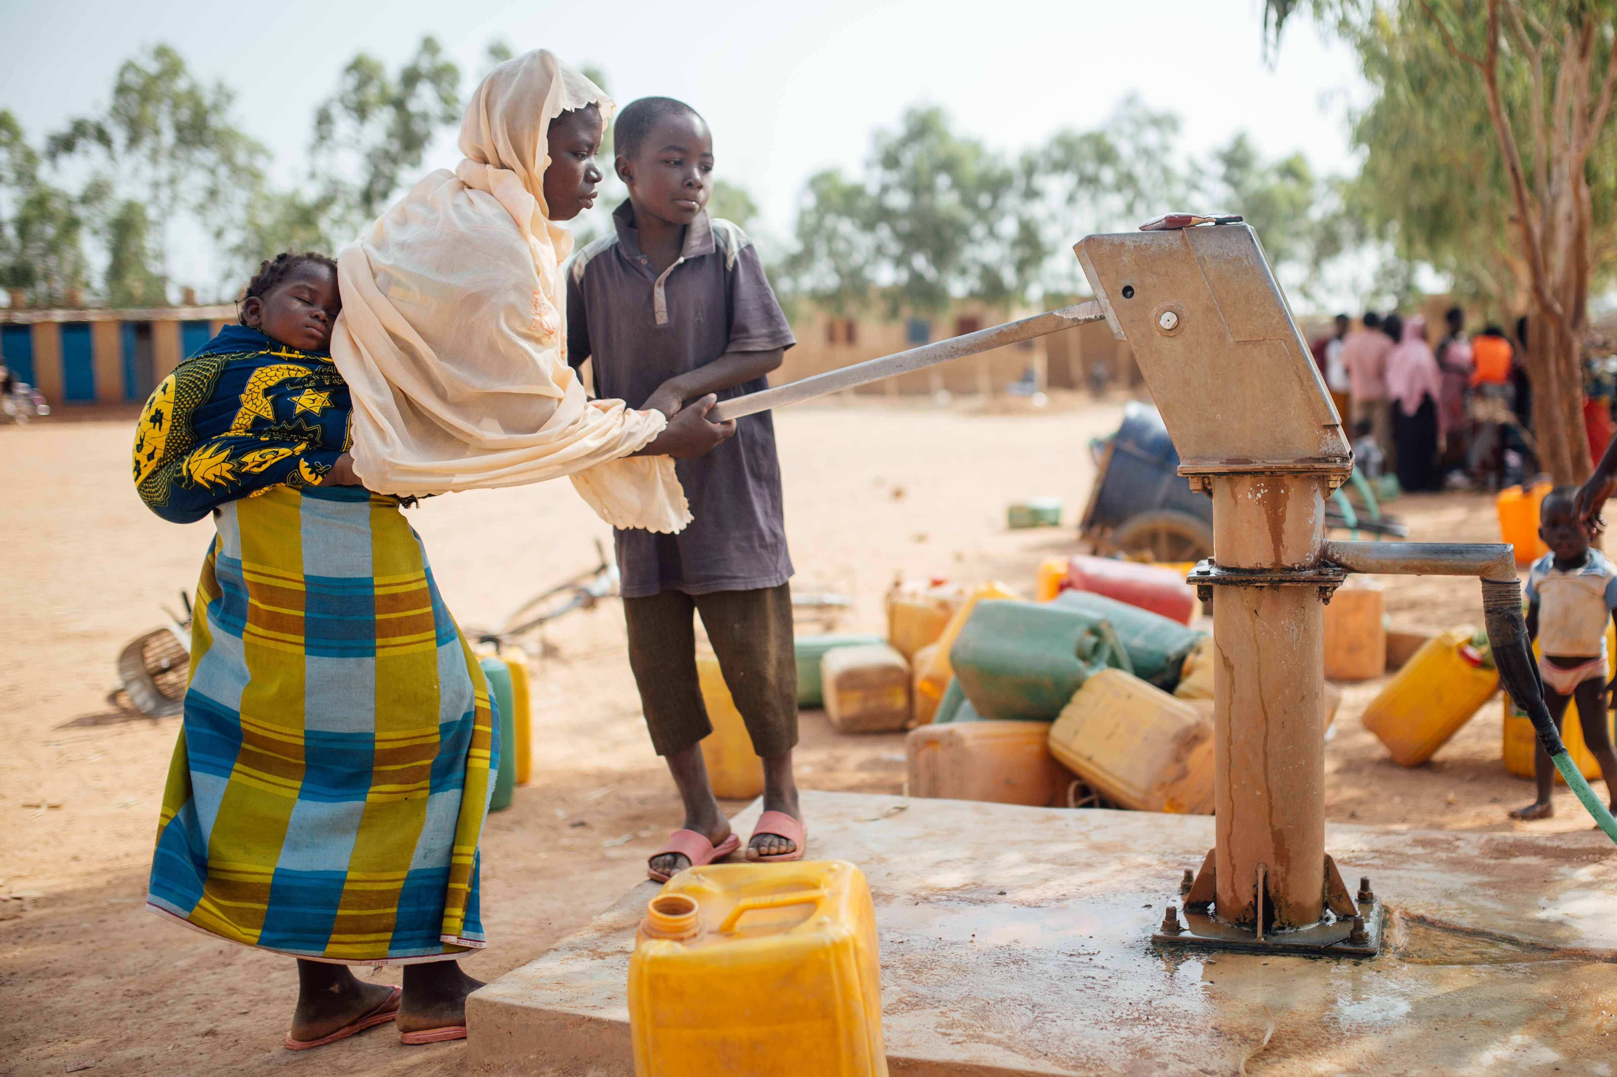

Slide 12
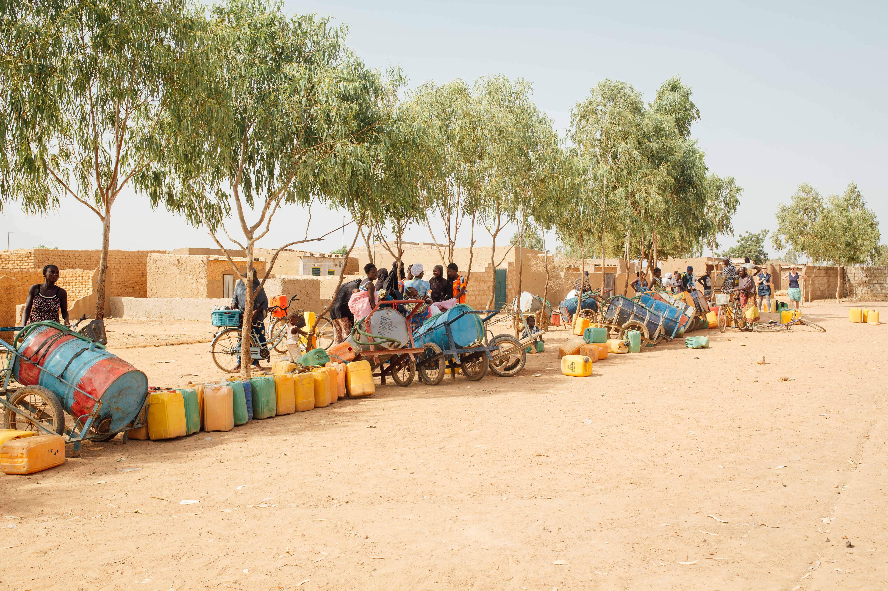

Slide 13
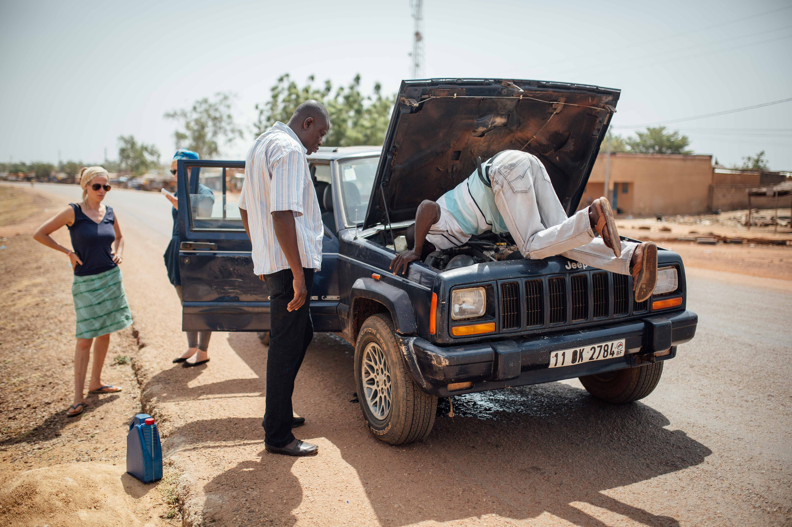

Slide 14
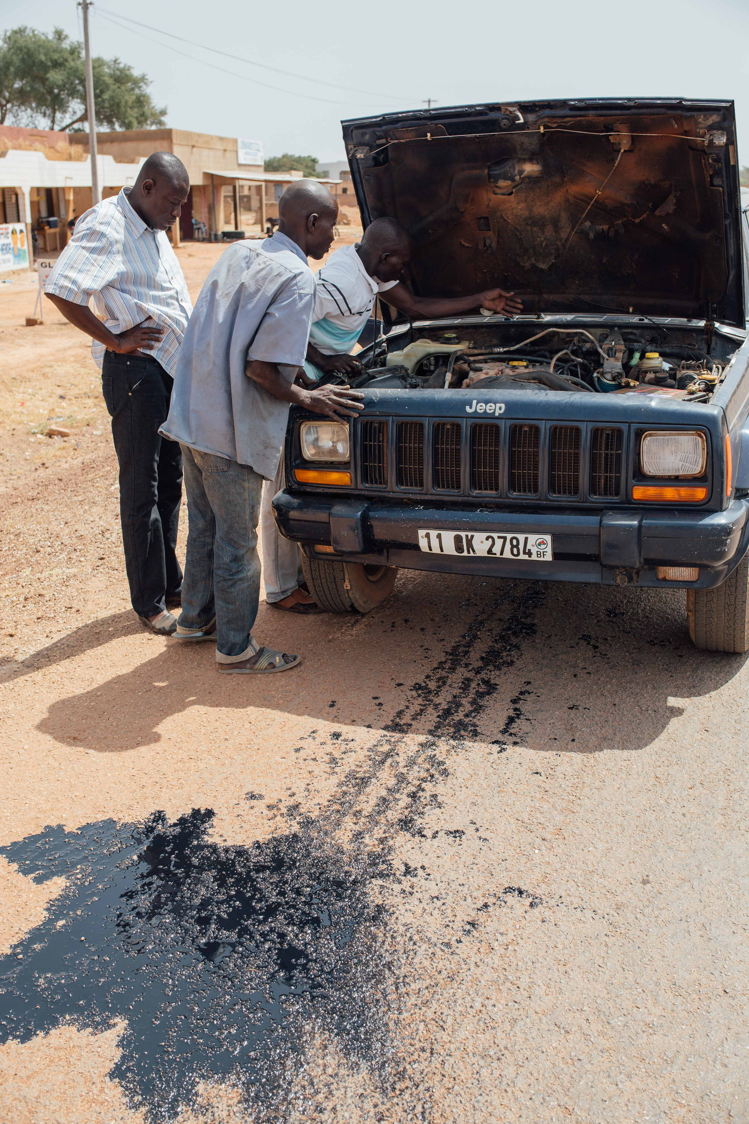

Slide 15
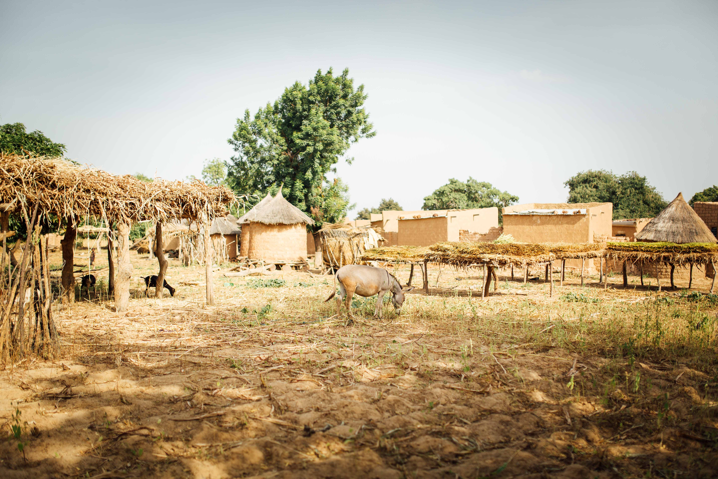

Slide 16
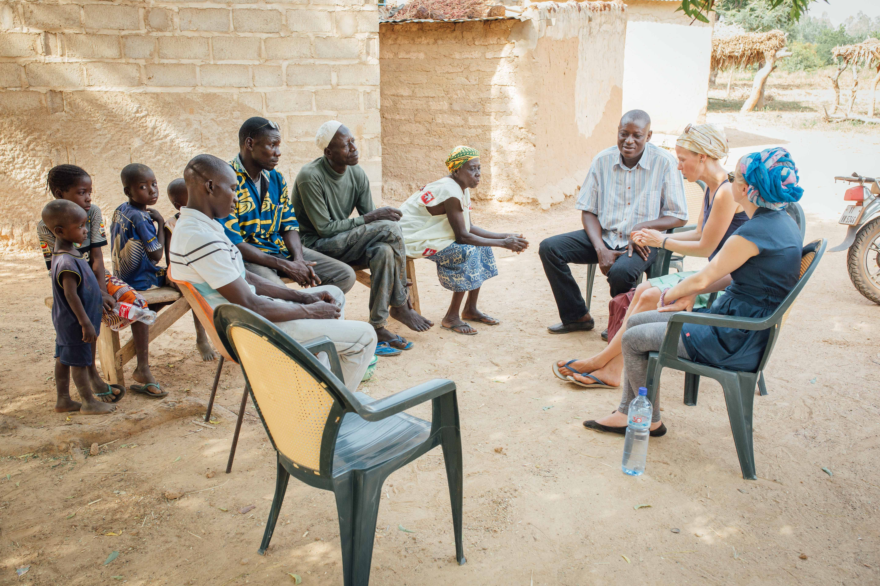

Slide 17
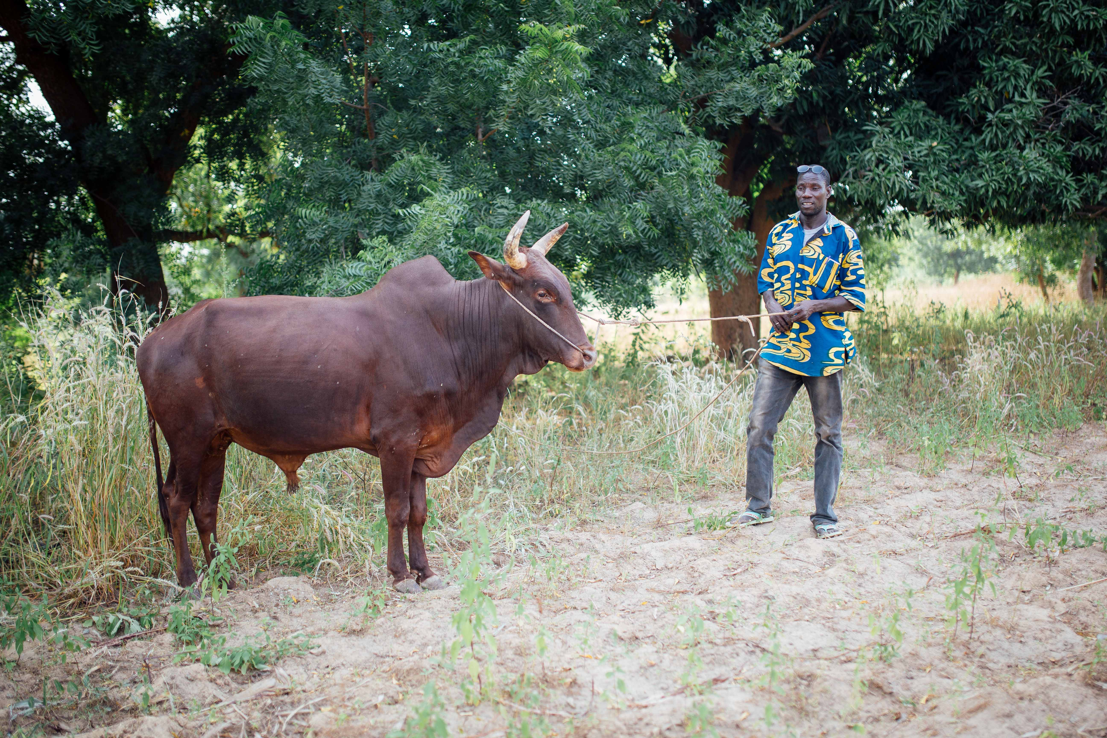

Slide 18
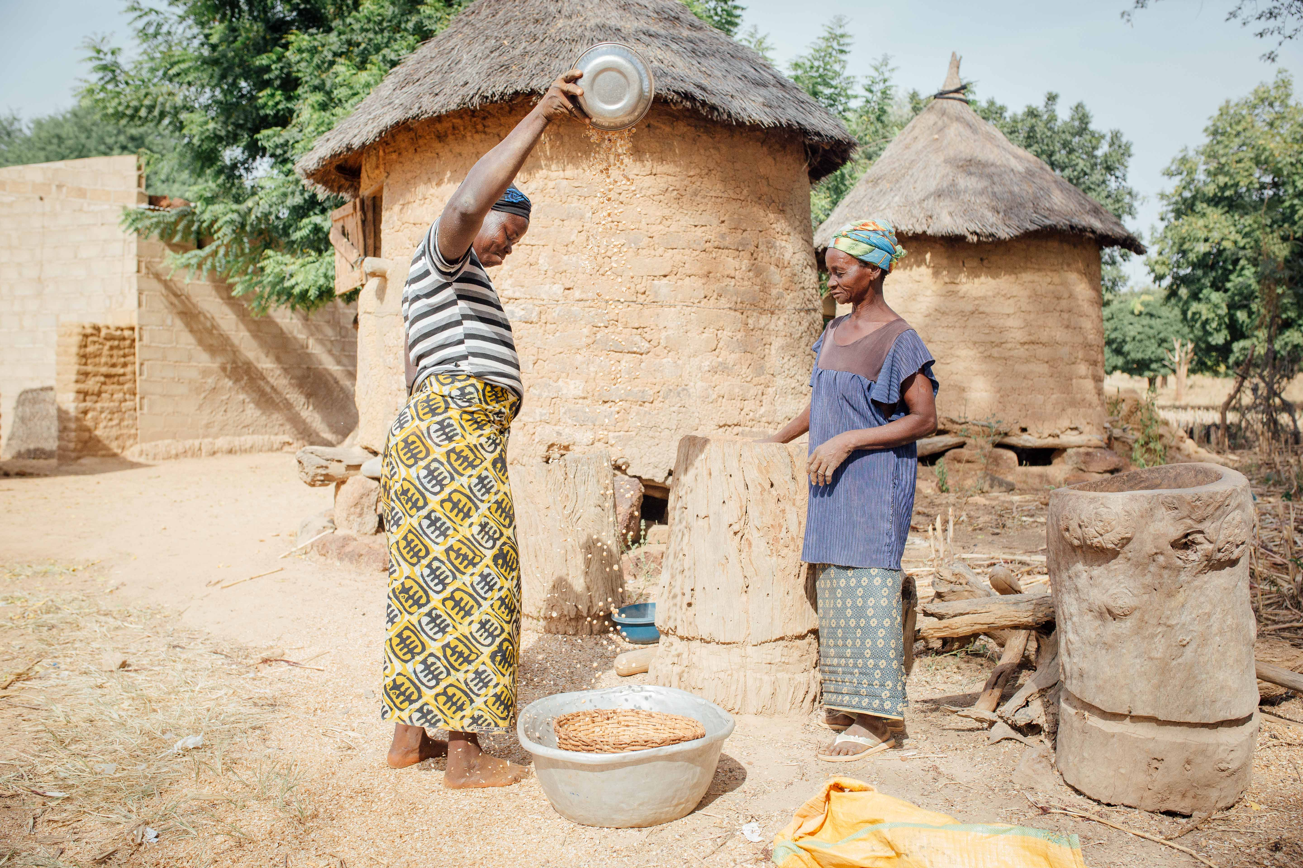

Slide 19
Thank you
www.agbe.org

